Slide 1

DISCLAIMER
The information in this presentation is provided to you by PT. AXAR Technology Raya, solely for informational purposes and does not constitute an offer to buy, sell or issue, or a solicitation of an offer to sell, buy or acquire any securities of the Company in any jurisdiction or an inducement to enter into investment activity, nor may it or any part of it form the basis of or be relied on in connection with any contract or commitment whatsoever. No representations or warranties, express or implied, are made by the Company, any underwriters, any of their respective affiliates, directors, officers, employees, advisors or representatives with respect to, and no reliance should be placed, on the accuracy, fairness or completeness of the information presented or contained in this presentation. By viewing this presentation, you agree that none of the Company, any underwriters, nor any of their respective affiliates, directors, officers, employees, advisors or representatives accepts any responsibility or liability whatsoever for any loss howsoever arising from any information presented or contained in or derived from or omitted from this presentation. The information presented or contained in this presentation was obtained from various sources, including certain third parties, and has not been independently verified, and its accuracy is not guaranteed.
This presentation does not contain all relevant information relating to the Company or its securities, particularly with respect to the risks and special considerations involved with an investment in the securities of the Company. These materials are not an offer of securities for sale. Any public offering will be made by means of a prospectus that may be obtained from the issuer and that will contain detailed information about the company and management, as well as financial statements. This presentation speaks as of its date and the information presented or contained in this presentation is subject to change without notice or update.
This presentation contains statements that constitute forward-looking statements. These statements include descriptions regarding the intent, belief or current expectations of the Company or its officers about the future. These statements can be recognized by the use of words such as “expects,” “plans,” “will,” “estimates,” “projects,” “intends,” or words of similar meaning. Such forward-looking statements are not guarantees of future performance and involve risks and uncertainties, and actual results may differ from those in the forward-looking statements as a result of various factors and assumptions, many of which are beyond the Company’s control. The Company or any of its affiliates, advisors, representatives or underwriters has no obligation and does not undertake to revise forward-looking statements to reflect future events or circumstances.
THE INFORMATION CONTAINED IN THIS DOCUMENT IS HIGHLY CONFIDENTIAL AND MAY NOT BE FORWARDED, PUBLISHED OR DISTRIBUTED, DIRECTLY OR INDIRECTLY, TO ANY OTHER PERSON (WHETHER WITHIN OR OUTSIDE YOUR ORGANIZATION/FIRM) FOR ANY PURPOSE AND MAY NOT BE REPRODUCED IN ANY MANNER WHATSOEVER. ANY FORWARDING, PUBLICATION, DISTRIBUTION OR REPRODUCTION OF THIS DOCUMENT IN WHOLE OR IN PART IS UNAUTHORIZED.
MOBILE
DEVELOPMENT
DAY 1

Slide 2
OBJECTIVES
State Management
Notes:
Save Time....:
The Platform will house/aggregate thousands of DIRECT SUPPLIERS. Buyer members are now abled to easily Pick whats best suitable for them.
Discover...:
Suppliers need to be a registered and verified members. There will be features such as ratings and certifications to boost further.
Grow Business:
Members akan di-empowered dengan sebuah tool digital yang yang tadinya menyerang industri, malah justru membuat mereka bisa menjadi lebih kompetitif di era digital.

Slide 3
State Management
Di Flutter, ada saatnya Anda perlu membagikan state aplikasi antar layar, di seluruh aplikasi. Ada banyak pendekatan yang dapat Anda ambil.
Di materi berikut, Anda akan mempelajari dasar-dasar mengelola state di aplikasi Flutter.
Flutter bersifat deklaratif. Artinya Flutter membangun antarmuka penggunanya untuk mencerminkan state aplikasi Anda saat ini:
Notes:
Save Time....:
The Platform will house/aggregate thousands of DIRECT SUPPLIERS. Buyer members are now abled to easily Pick whats best suitable for them.
Discover...:
Suppliers need to be a registered and verified members. There will be features such as ratings and certifications to boost further.
Grow Business:
Members akan di-empowered dengan sebuah tool digital yang yang tadinya menyerang industri, malah justru membuat mereka bisa menjadi lebih kompetitif di era digital.

Slide 4
State Management : Thinking Declarative
Saat status aplikasi Anda berubah (misalnya, pengguna menekan tombol switch di layar setelan), Anda mengubah state tersebut, dan itu memicu penggambaran ulang antarmuka pengguna. Tidak ada perubahan penting dari UI itu sendiri (seperti widget.setText). Anda mengubah state, dan UI akan dibangun kembali dari awal.
Gaya deklaratif pemrograman UI memiliki banyak manfaat. Hebatnya, hanya ada satu jalur kode untuk setiap status UI. Anda mendeskripsikan seperti apa tampilan UI untuk setiap status tertentu, sekali dan hanya itu.
Notes:
Save Time....:
The Platform will house/aggregate thousands of DIRECT SUPPLIERS. Buyer members are now abled to easily Pick whats best suitable for them.
Discover...:
Suppliers need to be a registered and verified members. There will be features such as ratings and certifications to boost further.
Grow Business:
Members akan di-empowered dengan sebuah tool digital yang yang tadinya menyerang industri, malah justru membuat mereka bisa menjadi lebih kompetitif di era digital.

Slide 5
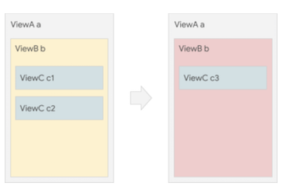
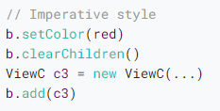
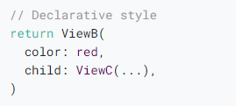
Management State : Imperative VS Declarative
Imperative
Declarative
Notes:
Save Time....:
The Platform will house/aggregate thousands of DIRECT SUPPLIERS. Buyer members are now abled to easily Pick whats best suitable for them.
Discover...:
Suppliers need to be a registered and verified members. There will be features such as ratings and certifications to boost further.
Grow Business:
Members akan di-empowered dengan sebuah tool digital yang yang tadinya menyerang industri, malah justru membuat mereka bisa menjadi lebih kompetitif di era digital.

Slide 6
Judul
Ephemeral state (terkadang disebut state UI atau state lokal) adalah keadaan yang dapat Anda isi dengan rapi dalam satu widget.
Contoh :
halaman saat ini di PageView
kemajuan animasi kompleks saat ini
tab yang dipilih saat ini di BottomNavigationBar
Bagian lain dari pohon widget jarang perlu mengakses status semacam ini. Tidak perlu membuat serial, dan tidak berubah dengan cara yang rumit.
Ephemeral state hanya perlu menggunakan StatefulWidget.
Di bawah, Anda melihat bagaimana item yang saat ini dipilih di bilah navigasi bawah disimpan di bidang _index dari kelas _MyHomepageState. Dalam contoh ini, _index adalah status ephemeral.
Notes:
Save Time....:
The Platform will house/aggregate thousands of DIRECT SUPPLIERS. Buyer members are now abled to easily Pick whats best suitable for them.
Discover...:
Suppliers need to be a registered and verified members. There will be features such as ratings and certifications to boost further.
Grow Business:
Members akan di-empowered dengan sebuah tool digital yang yang tadinya menyerang industri, malah justru membuat mereka bisa menjadi lebih kompetitif di era digital.

Slide 7
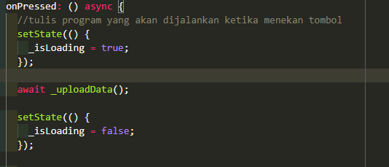
State Management : Epheral State
Berikut ini adalah contoh epheral state untuk untuk loading progress :
Notes:
Save Time....:
The Platform will house/aggregate thousands of DIRECT SUPPLIERS. Buyer members are now abled to easily Pick whats best suitable for them.
Discover...:
Suppliers need to be a registered and verified members. There will be features such as ratings and certifications to boost further.
Grow Business:
Members akan di-empowered dengan sebuah tool digital yang yang tadinya menyerang industri, malah justru membuat mereka bisa menjadi lebih kompetitif di era digital.

Slide 8
App State
App state merupakan state yang ingin Anda bagikan ke banyak bagian aplikasi, dan yang ingin Anda pertahankan di antara sesi pengguna, adalah yang kami sebut status aplikasi (terkadang juga disebut status bersama).
Contoh :
Preferensi user
Login info
Notification
Keranjang belanja di aplikasi e-commerce
Status artikel yang dibaca / belum dibaca di aplikasi berita
Dan lainnya.
Notes:
Save Time....:
The Platform will house/aggregate thousands of DIRECT SUPPLIERS. Buyer members are now abled to easily Pick whats best suitable for them.
Discover...:
Suppliers need to be a registered and verified members. There will be features such as ratings and certifications to boost further.
Grow Business:
Members akan di-empowered dengan sebuah tool digital yang yang tadinya menyerang industri, malah justru membuat mereka bisa menjadi lebih kompetitif di era digital.

Slide 9
App State
Ada banyak cara untuk mengelola app state, seperti menggunna Redux, Rx, hooks, dan lain-lain.
Namun dalam tahap awal ini kita dapat menggunakan sharedpreferences untuk mengelola suatu state di beberapa widget atau seluruh widget.
shared_preference merupakan sebuah plugin flutter yang memungkinkan user menyinpan suatu data dalam bentuk hash yang di simpan dalam memori.
Penggunaan shared_preference mirip seperti menggunakan map, kita harus menyiapkan sebuah key untuk sebuah data yang akan disimpan dalam memori. seperti data login, preferensi user dan lain-lain.
Notes:
Save Time....:
The Platform will house/aggregate thousands of DIRECT SUPPLIERS. Buyer members are now abled to easily Pick whats best suitable for them.
Discover...:
Suppliers need to be a registered and verified members. There will be features such as ratings and certifications to boost further.
Grow Business:
Members akan di-empowered dengan sebuah tool digital yang yang tadinya menyerang industri, malah justru membuat mereka bisa menjadi lebih kompetitif di era digital.

Slide 10


App State
Berikut ini adalh contoh potongan code penggunaan shared_prefrence dalam menyimpan data login.
Silahkan daftarkan plugin pada pubspec.yaml
Kemudian tambahkan kode sebagai berikut pada method login anda :
Notes:
Save Time....:
The Platform will house/aggregate thousands of DIRECT SUPPLIERS. Buyer members are now abled to easily Pick whats best suitable for them.
Discover...:
Suppliers need to be a registered and verified members. There will be features such as ratings and certifications to boost further.
Grow Business:
Members akan di-empowered dengan sebuah tool digital yang yang tadinya menyerang industri, malah justru membuat mereka bisa menjadi lebih kompetitif di era digital.

Slide 11
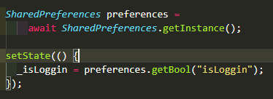
App State
Setelah mengeksekusi code sebelumnya.
Maka perangkat smartphone telah menyimpang sebuah data hash dengan key “isLoggin”.
Dengan disimpannya data tersebut dalam memori, developer dapat menggunkannya untuk mengidentifikasi user apakah user tersebut sudah login atau belum.
Berikut ini adalah cara mengakses data menggunakan shared_preferences.
Notes:
Save Time....:
The Platform will house/aggregate thousands of DIRECT SUPPLIERS. Buyer members are now abled to easily Pick whats best suitable for them.
Discover...:
Suppliers need to be a registered and verified members. There will be features such as ratings and certifications to boost further.
Grow Business:
Members akan di-empowered dengan sebuah tool digital yang yang tadinya menyerang industri, malah justru membuat mereka bisa menjadi lebih kompetitif di era digital.

Slide 12
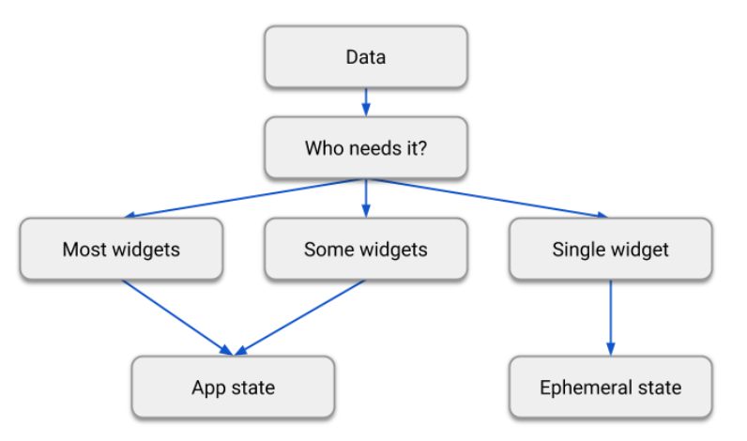
Epheneral State VS App State
Berikut ini adalah perbedaan mendasar mengenai epheral state dan app state.
Jika data dibutuh oleh banyak widget, silahkan menggunakan app state, jika data hanya digunakan oleh sebuah widget silahkan menggunakan app state.
Notes:
Save Time....:
The Platform will house/aggregate thousands of DIRECT SUPPLIERS. Buyer members are now abled to easily Pick whats best suitable for them.
Discover...:
Suppliers need to be a registered and verified members. There will be features such as ratings and certifications to boost further.
Grow Business:
Members akan di-empowered dengan sebuah tool digital yang yang tadinya menyerang industri, malah justru membuat mereka bisa menjadi lebih kompetitif di era digital.

Slide 13
DISCLAIMER
The information in this presentation is provided to you by PT. AXAR Technology Raya, solely for informational purposes and does not constitute an offer to buy, sell or issue, or a solicitation of an offer to sell, buy or acquire any securities of the Company in any jurisdiction or an inducement to enter into investment activity, nor may it or any part of it form the basis of or be relied on in connection with any contract or commitment whatsoever. No representations or warranties, express or implied, are made by the Company, any underwriters, any of their respective affiliates, directors, officers, employees, advisors or representatives with respect to, and no reliance should be placed, on the accuracy, fairness or completeness of the information presented or contained in this presentation. By viewing this presentation, you agree that none of the Company, any underwriters, nor any of their respective affiliates, directors, officers, employees, advisors or representatives accepts any responsibility or liability whatsoever for any loss howsoever arising from any information presented or contained in or derived from or omitted from this presentation. The information presented or contained in this presentation was obtained from various sources, including certain third parties, and has not been independently verified, and its accuracy is not guaranteed.
This presentation does not contain all relevant information relating to the Company or its securities, particularly with respect to the risks and special considerations involved with an investment in the securities of the Company. These materials are not an offer of securities for sale. Any public offering will be made by means of a prospectus that may be obtained from the issuer and that will contain detailed information about the company and management, as well as financial statements. This presentation speaks as of its date and the information presented or contained in this presentation is subject to change without notice or update.
This presentation contains statements that constitute forward-looking statements. These statements include descriptions regarding the intent, belief or current expectations of the Company or its officers about the future. These statements can be recognized by the use of words such as “expects,” “plans,” “will,” “estimates,” “projects,” “intends,” or words of similar meaning. Such forward-looking statements are not guarantees of future performance and involve risks and uncertainties, and actual results may differ from those in the forward-looking statements as a result of various factors and assumptions, many of which are beyond the Company’s control. The Company or any of its affiliates, advisors, representatives or underwriters has no obligation and does not undertake to revise forward-looking statements to reflect future events or circumstances.
THE INFORMATION CONTAINED IN THIS DOCUMENT IS HIGHLY CONFIDENTIAL AND MAY NOT BE FORWARDED, PUBLISHED OR DISTRIBUTED, DIRECTLY OR INDIRECTLY, TO ANY OTHER PERSON (WHETHER WITHIN OR OUTSIDE YOUR ORGANIZATION/FIRM) FOR ANY PURPOSE AND MAY NOT BE REPRODUCED IN ANY MANNER WHATSOEVER. ANY FORWARDING, PUBLICATION, DISTRIBUTION OR REPRODUCTION OF THIS DOCUMENT IN WHOLE OR IN PART IS UNAUTHORIZED.
THANK YOU

